Slide 1
SUSY analysis with same-sign leptons in ATLAS
Nicole Ruckstuhl, BND-school 2009

Slide 2
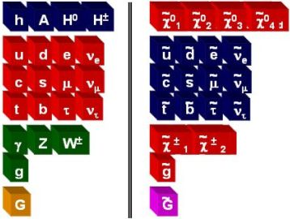
(Minimal) SuperSymmetry
Supersymmetry predicts a partner for each SM particle.
Interactions involving SUSY particles are the same as SM interactions!
SUSY partners have the same charges (EM/color).
The couplings have the same strength.
Neutral and charged bosiono’s mix into neutralino’s and chargino’s

Slide 3
SUSY Breaking and R-Parity
New interactions.
Direct mass terms : SUSY particles are heavier than SM partner.
The couplings for SM-like interactions involving SUSY particle are unchanged.
SUSY particles are always produced in pairs.
SUSY particles always decay to another SUSY particle + SM particles
The lightest SUSY particle (LSP) is stable.
SUSY events will always consist of 2 decay chains.

Slide 4
SUSY signals
SUSY signals at the LHC depend on phase space point.
Some features are common to “most” points.
If χ⁰₁is the LSP, 2 massive particle remain undetected:
High Missing E_{T}
Sqarks and gluino’s are often the initial particles.
They decay to the LSP through sfermions and bosino’s.
Long decay chains with many leptons and jets
Decay chains more of less independent.
Two same-sign leptons possible

Slide 5
SUSY signals
High Missing E_{T}
At least 2 high energetic jets
Exactly 2 same-sign high energy leptons

Slide 6
Backgrounds
What SM background can have:
high missing E_{T},
at least 2 high energy jets,
exactly 2 same sign leptons (no tau’s)
Sample | SS-leptons | Missing E_{T} | jets | X-section (pb)
tt | no | yes | yes | 217.1
W+jets | no | yes | yes | 4.8·10⁴
t | no | yes | yes | 43.2
W+bb | no | yes | yes | 17.9
Z+jets | no | no | yes | 4.3·10³
Wt | no | yes | yes | 14.4
WW | no | yes | no | 15.5
ZZ | yes | no | no | 1.4
And QCD

Slide 7
Same-Sign Lepton Analysis
Possible event Selection:
Missing E_{T} > 80 GeV
At least two high energy jets (P_{T} > 80 GeV)
Exactly two ss-leptons (P_{T} >20 GeV)
Sample | Events after selection (200 pb⁻¹)
SM | 1.3±0.2
SU1 | 2.4±0.4
SU3 | 2.7±0.7
SU4 | 40.2±4.4
SU6 | 1.1±0.2
How to determine the background?
Efficiencies are “easy”
Fake rates are more complicated

Slide 8
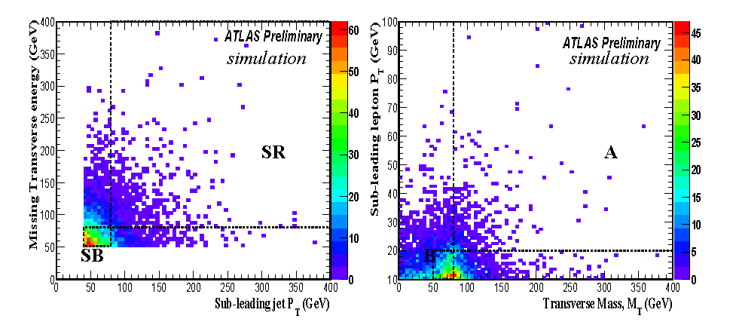
Background estimation method
M_{T}=Missing E_{T} + P_{T} leptons + P_{T} jets
A_{SR} is the signal region.
The background is A_{SR} can be estimated by:
A’_{SR}= (A_{SB}/ B_{SB})B_{SR}

Slide 9
Results
Data | Signal+BG | Esimated BG
No SUSY | 1.3±0.2 | 1.6±1.1
SU1 | 3.7±0.5 | 1.6±1.2
SU3 | 4.0±0.7 | 1.6±1.1
SU4 | 41.5±4.4 | 6.2±3.2
SU6 | 2.4±0.3 | 1.6±1.2
How sure is this method.
Some systematic studies already done, (jet energy scale, jet energy resolution, different generator.)
More needs doing: Effect of fake rate.
Use some information about correlation.

