Slide 1
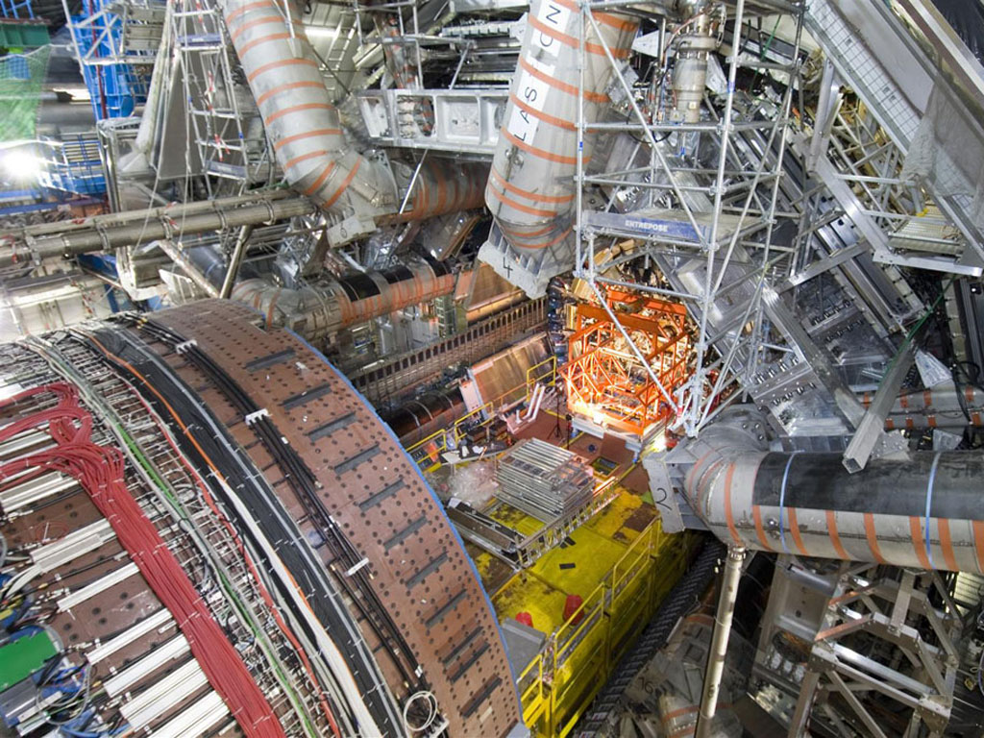
Studies for the Single Top Quark t-channel measurement with the ATLAS experiment
Ph. Sturm
D. Hirschbühl, W. Wagner
Bergische Universität Wuppertal
BND School Rathen 2009
21.09.2009
All work shown is work in
progress and not necessarily a final result!

Slide 2
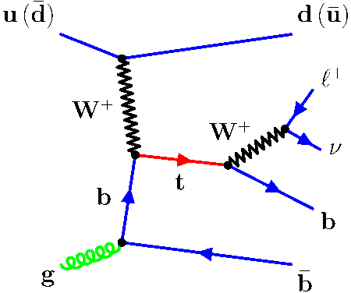
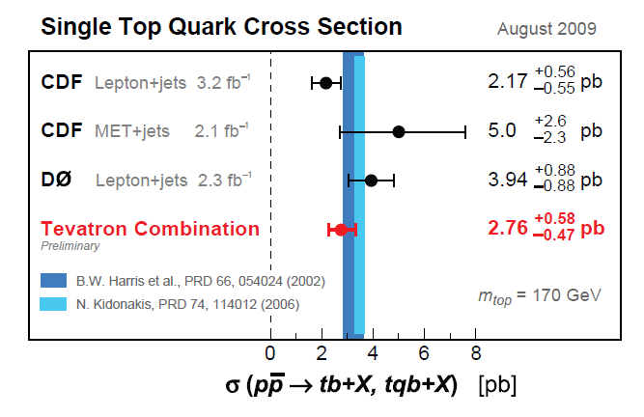
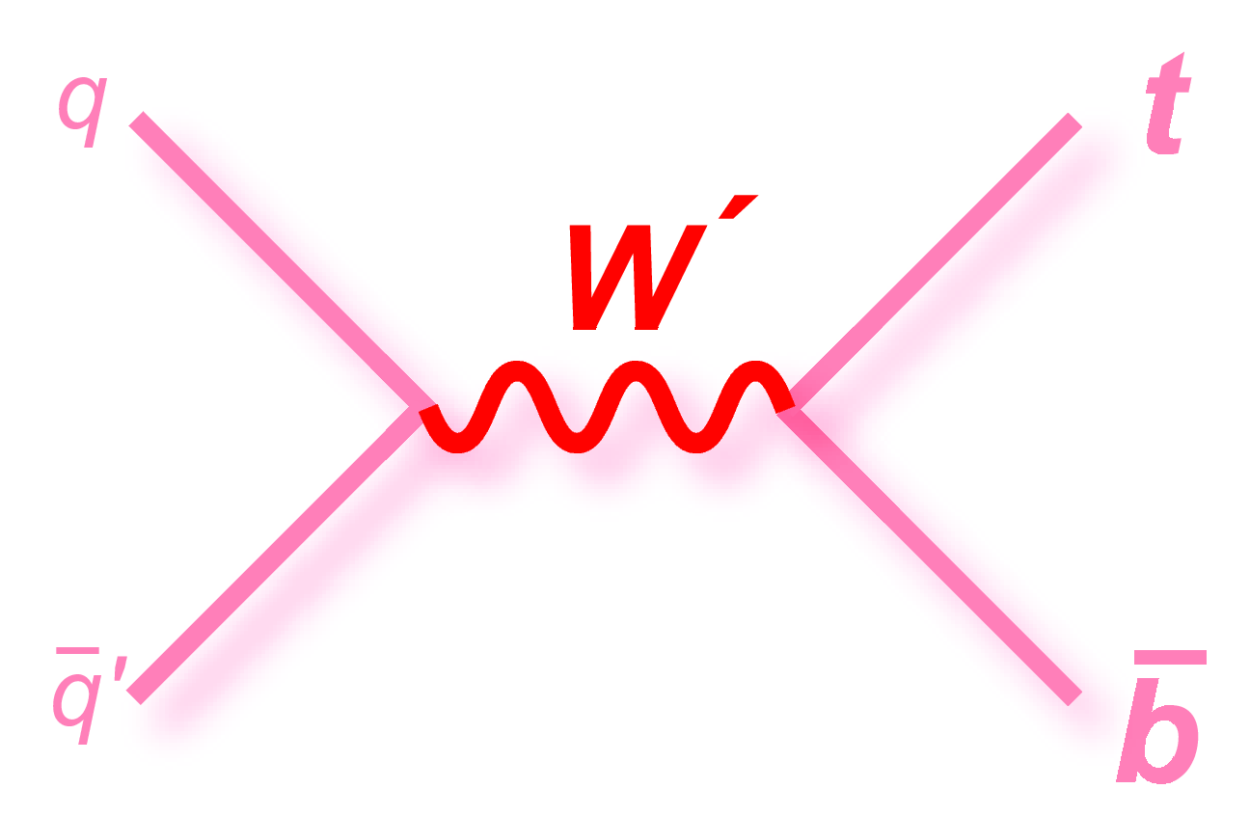
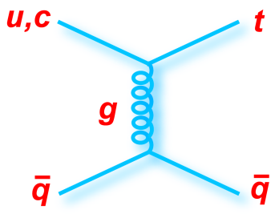
Single Top Quark Production
Test of V-A structure of Wtb coupling
Direct measurement of |V_{tb}|²
Test of the b-quark pdf
Sensitive to new physics (4th generation, couplings, production modes, loop effects)
Background for physics searches beyond the standard model
confirmation of the Tevatron discovery
heavy W’,
charged H,…
FCNC

Slide 3
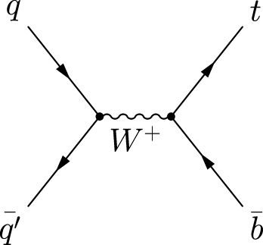
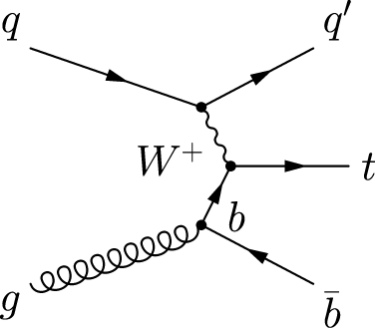
Single Top Quark Production
s-channel
t-channel
associated production
√s | s-channel | t-channel | Wt
1.96 TeV | 0.88 | 1.98 | 0.094
7 TeV | 3.1 | 65 | 10.6
10 TeV | 5.2 | 135.7 | 26.5
14 TeV | 10.7 | 247 | 56
Exciting at the LHC @ 14 TeV:
t-channel x-sec rises by factor ~120
W+jets x-sec rises only by factor ~10
High luminosity
t-channel production is the most promising channel for first data (<1/fb)
B.W. Harris et. al. Phys. Rev. D66,054024 T.Tait Phys. Rev D61,34001

Slide 4
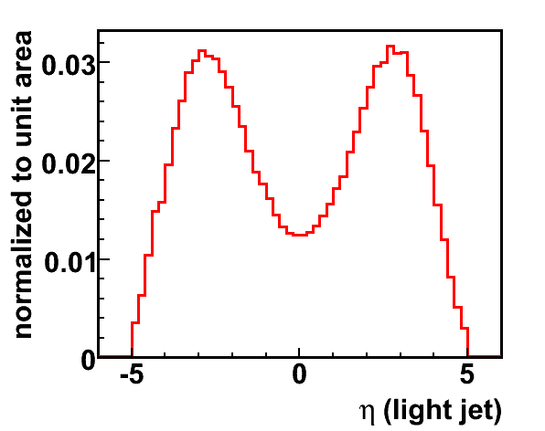
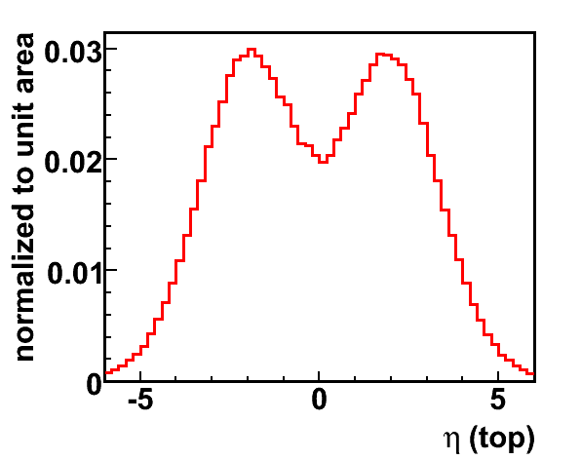
Event Topology
1 forward light jet
Top Decay:
b-jet
Leptonic W decay 1 high P_{T} e or μ Missing transverse energy
second b-jet if visible
ZTOP: Sullivan, Z. Phys. Rev. D70 (2004) 114012

Slide 5
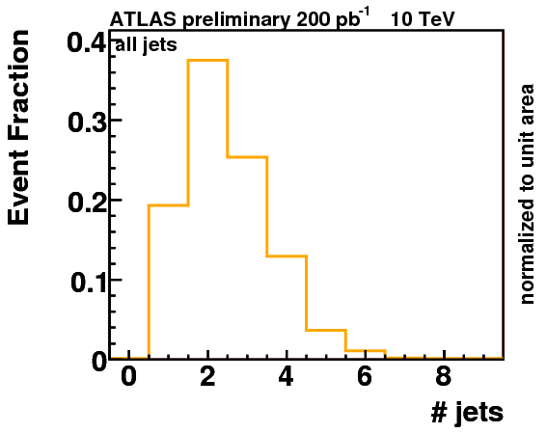
t-channel Event Selection
Trigger
e15_medium / mu15
Lepton selection (electron / muon):
p_{T} > 20 GeV/c
|η|< 2.5, electron not in crack region
etcone20 < 6 GeV
Jets
Cone4H1Tower
p_{T} > 30 GeV/c²
|η|< 5
b-tagging
JetProb e_{b}= 45%, rej. = 93
Overlap removal
1. select electrons
2. remove overlapping jets ΔR < 0.2
3. remove muons overlapping with jets ΔR < 0.3
Exactly one lepton
2 or 3 jets
1 b-tagged jet
E_{T,miss} > 20 GeV

Slide 6
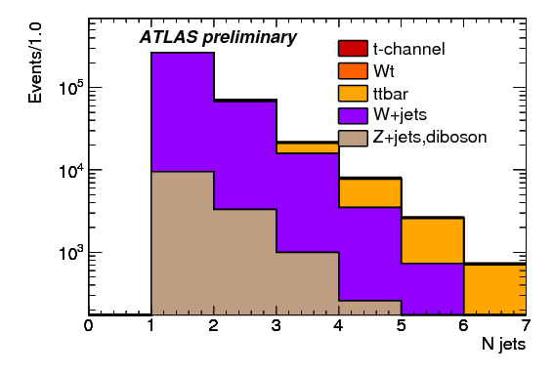
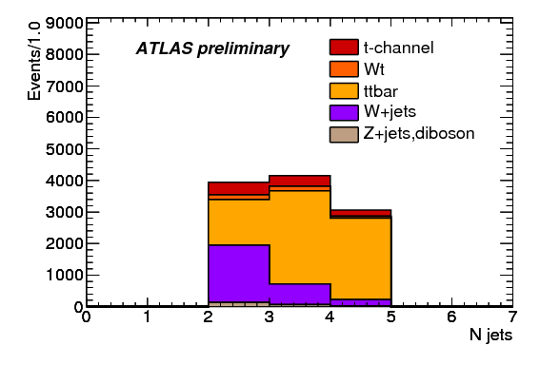
Analysis Strategy
Before b-tagging (pretag)
After b-tagging
Validation of NN techniques
Extraction of t-channel cross section using neural networks
Normalization of tt and W+jets background using neural networks

Slide 7
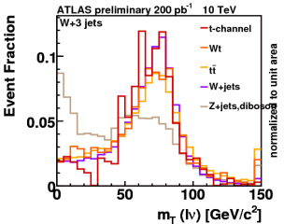
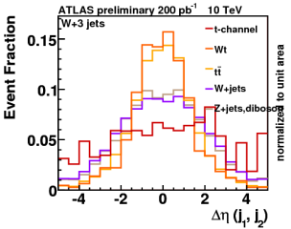
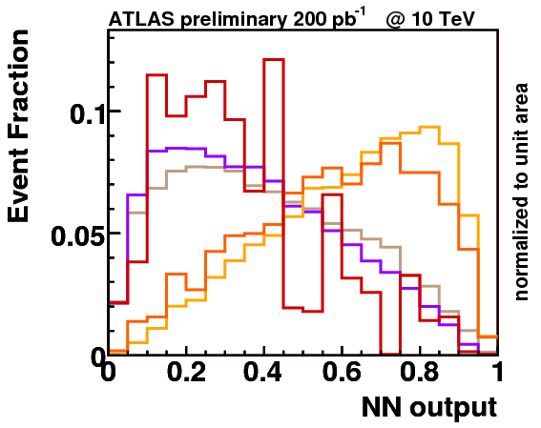
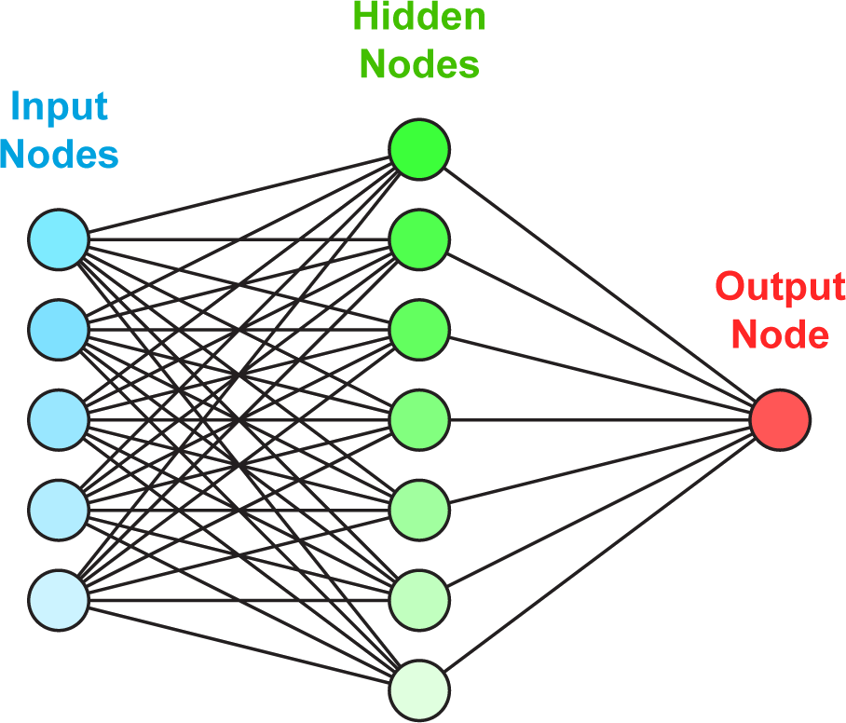
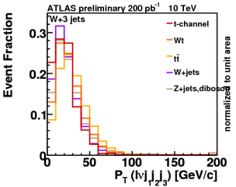
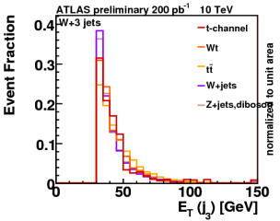
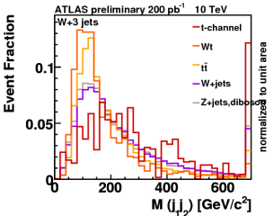
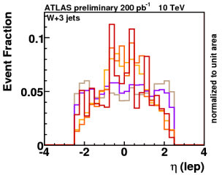
Neuronal Network Techniques
Feed forward NN (15 hidden nodes) with variable preprocessing (NeuroBayes)
Trained with events with 3 jets, no b-tag information
Training was done only with W+jets and tt (50% / 50%) with 10 input variables

Slide 8
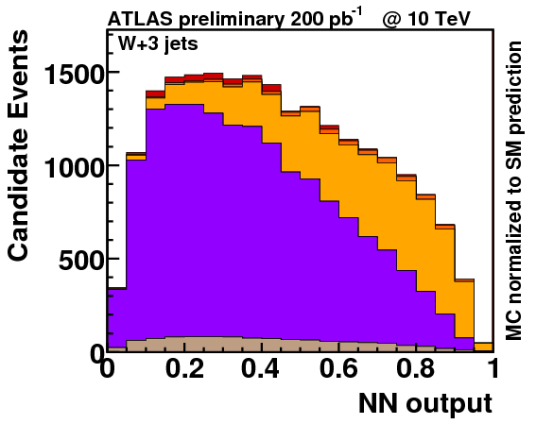
Determination of tt and W+Jet fractions
Process
W + jets | 68%
Z + jets, diboson | 5%
tt | 24%
Wt/t-channel | 3%
Fit output to (pseudo)-data to determine fraction of tt and W+jet events.
Fraction of Wt & t-channel fixed to prediction, Z + jets using Gaussian constrain of 20%.

Slide 9
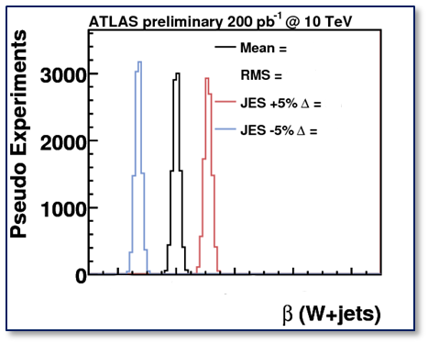
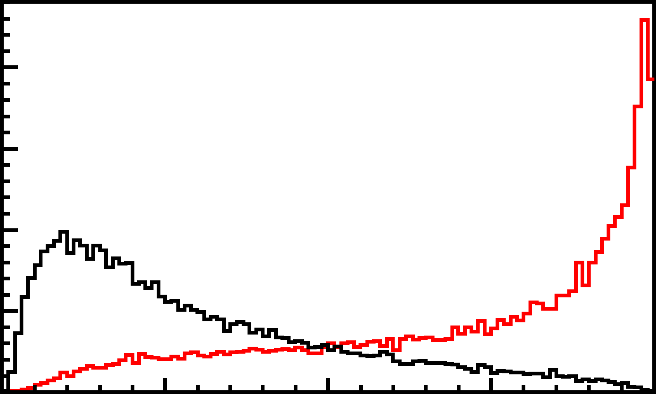
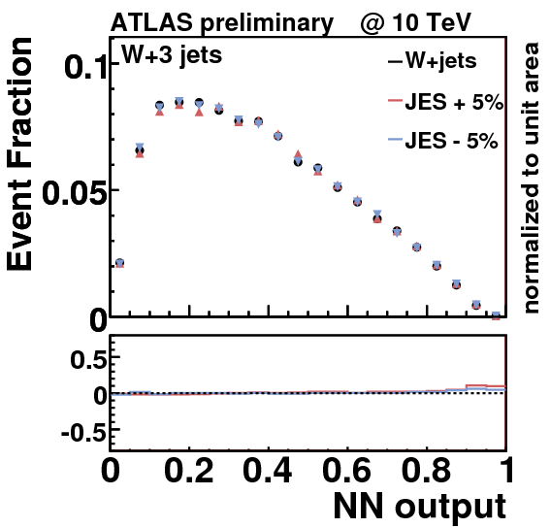
Sensitivity and Systematic Uncertainty on the Background Estimation
The sensitivity of the fit is determined by pseudoexperiments – the RMS of the distribution gives the statistical uncertainty
Systematic Uncertainties affect the shape of the NN output distribution and the rate of the Number of expected events
Important Systematic Uncertainties are:
Jet Energy Scale
PDF Uncertainty
ISR/FSR

Slide 10
Validation of the NN techniques
For this exercise we use a NN trained with events with 2 jets and at least 1 btg
Validation of input variables
and correlations
Events with 2 jet 0 tag
Each lepton type separately
Choose well modeled ones
For this exercise we used 10 variables
Δ η(j1,j₂)
p_{T}(light jet)
M(j₁,j₂)
SV1Weight
E_{T,miss}
Polarization angle
Helicity angle
η(lep)
p_{T} (lnj₁)
Train network
Validation of NN output
Events with 2 jet 0 tag
Slice & Dice 2 jet 0 tag
Output itself

Slide 11
Conclusion & Outlook
Aim for the first LHC data:
Develop data driven techniques to measure the W+Jets and tt background form the sidebands
Explore NN techniques for the analysis – develop methods to validate the MVA methods with data
Include all various sources of systematic uncertainties into the analysis
With enough integrated luminosity measurement of the single-top t-channel cross section
Probably with the 2010 data only the determination of an upper limit possible

